Slide 1
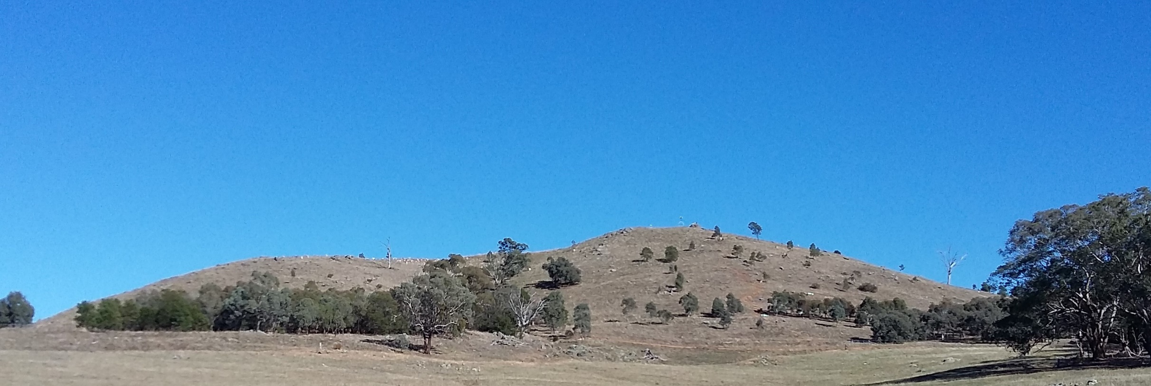
Planting Box-Gum Woodland on Mount Painter
Sarah Hnatiuk, Friends of Mount Painter
Woodland Forum, June 2018
Notes:
I am going to talk today about Friends of Mt Painter’s experience with planting tree and shrub tubestock as part of a program to re-establish open woodland on the hill.
Mt Painter is one of a chain of nature reserves in the ACT that runs north-west from Black Mountain to the Murrumbidgee River.
It was grazed by domestic stock until 1996 when it was added to the existing small reserve adjacent to the suburb of Cook.
At that stage, there were few trees on most of the new reserve. Planting of tubestock started in the late 1990s and has continued on and off ever since, guided since 2000 by a vegetation plan.
Friends of Mt Painter have been tracking the survival of the tubestock planted since 2005.

Slide 2
Tree & shrub tubestock survival to one year old
Year planted Per cent survival Rainfall (mm)
2005 23 648.6
2006 57 360.6
2007 56 565.8
2008 63 530.4
2009 66 443.4
2010 80 959.6
2011 77 580.1
Notes:
The 2005 planting was not a success: less than a quarter of the tubestock survived over the following summer. By contrast, 82% of community plantings organised that same year by Greening Australia survived to one year of age. This difference in survival rates stimulated us to consider how to do better on Mt Painter.
We changed our planting technique and cared for the tubestock , including watering them, over their first summer. As a result, we raised to survival rates to between a half and two-thirds of the tubestock planted during the drought years, 2006-09.
In 2010, the drought broke. Around the same time, a very successful rabbit control campaign was launched and kangaroo culling began; both have been continued since then. About 80% of the trees and shrubs planted in 2010 and 2011 survived.
Better survival results from strategic planting, ongoing care for the tubestock, good rainfall, and limited herbivore pressure.

Slide 3
Per cent survival to 2017 for planting years, 2006-11
Notes:
We have continued to follow plant survival over subsequent years; each line on the graph represents the results for a planting year. Mortality continues after the first year, although at a lesser rate.
The six planting years shown comprise four that had less rain than the long term average for Canberra and two that were wetter. At six years of age, mean survival is 45% for these six plantings. This figure gives some idea of the smallest number of tubestock that should be planted to reach a particular target for long term survival.

Slide 4
Mount Painter in 2002 (left) and 2018 (right)
Notes:
The result of all this planting is that there are now more trees and shrubs on Mt Painter than there were 20 years ago. The red line encloses the area where planting has occurred. More little black dots are apparent in 2018 than 16 years ago.
One outstanding task is to examine, with the planting so far, how many and how densely trees have established. Once the plan for the reserve is completed by the ACT Parks and Conservation Service, it will be possible to compare desired and actual results in woodland establishment.
We look forward to contributing to the development of the reserve plan.

