Slide 1
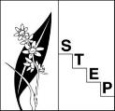
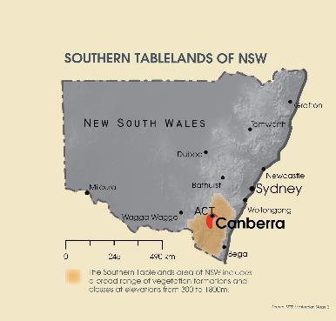
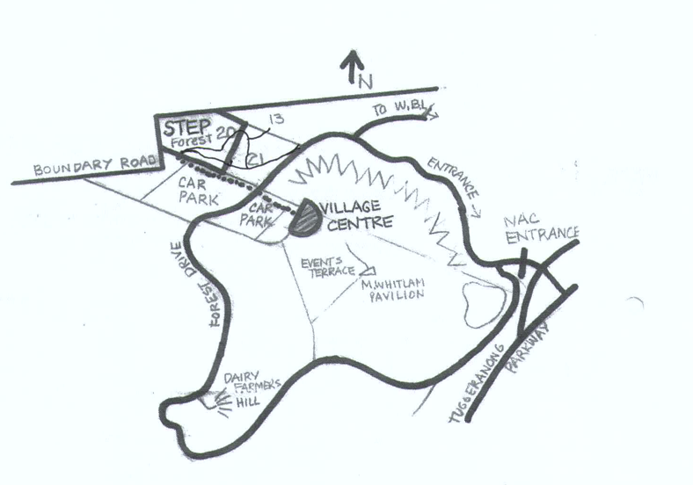
Southern Tablelands Ecosystems Park (STEP)
regional botanic garden - southern tablelands
located at Forest 20, National Arboretum Canberra – close to carparks and visitor centre

Slide 2
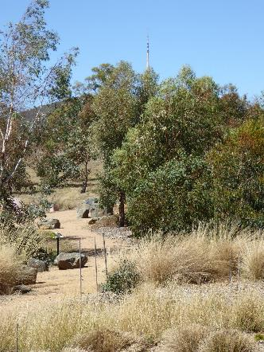
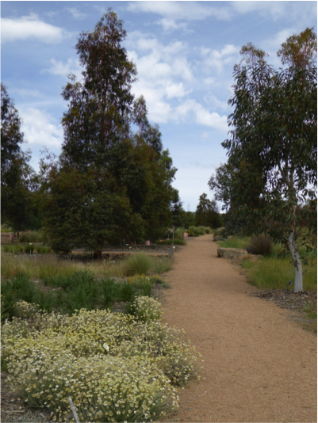
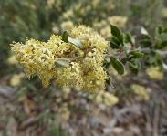
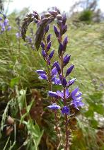
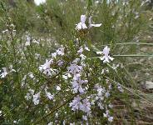
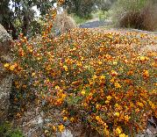
Southern Tablelands Ecosystems Park (STEP)
demonstration garden of region’s native flora and ecological communities

Slide 3
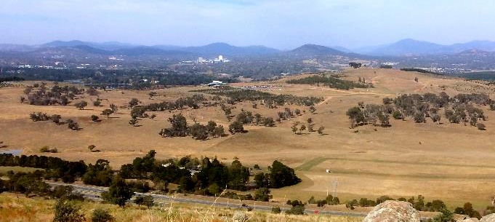
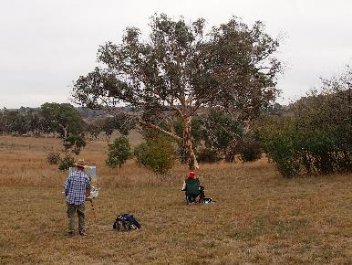
Southern Tablelands Ecosystems Park (STEP)
adjacent to Yellow Box – Red Gum woodland
Visitor Centre
STEP (Forest 20)
Woodland
COME AND VISIT YOUR REGIONAL BOTANIC GARDEN!

