Slide 1
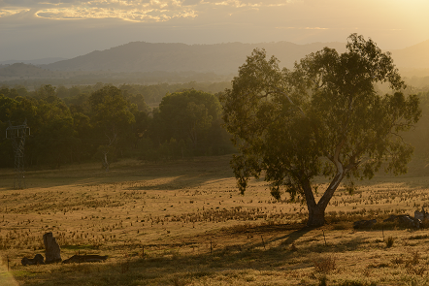

Ecosystem accounting for the Box Gum Grassy Woodlands
Heather Keith
Fenner School of Environment and Society
Heather.Keith@anu.edu.au
ACT Grassy Woodland Forum 28 June 2018

Slide 2
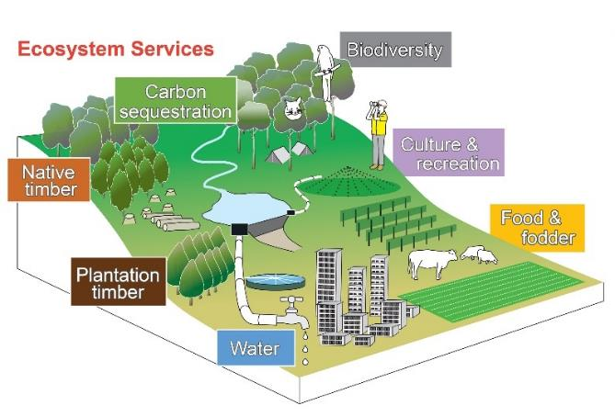
Ecosystem accounting
Ecosystem accounting
Provides the evidence base to inform decision-making:
Integrates all assets and services in a region
Translates environmental values into economic terms
Allows comparisons within a common framework
Evaluates trade-offs explicitly and spatially
Objective: To provide environmental information in a format relevant to informing
decision-making about natural resource management in a region

Slide 3
Place of accounting in the information system and policy cycle
The information system and the policy cycle
Review
Issue
Policy Cycle
Information system
Basic data
Accounts
Analysis
Policy
response
Monitoring
Implementation
Source: Vardon et al (2016). The accounting push and the policy pull. Ecol. Econ. 124: 145-152

Slide 4
System of Environmental-Economic Accounting
Ecosystem Accounting
Ecosystem assets:
defined spatial areas
comprise a combination of biotic and abiotic components that function together
measured in terms of their extent and condition
provide flows of ecosystem services
Ecosystem accounts provide information:
Standardised system comparable with the System of National Accounts
Classification that is exhaustive and mutually exclusive
Comprehensive coverage of land cover and land use
Structured tables of data that demonstrate logical relationships and statistical balances
Temporal consistency showing change over time
Spatial extent displayed as maps

Slide 5
Model of ecosystem accounting
Model of ecosystem accounting

Slide 6
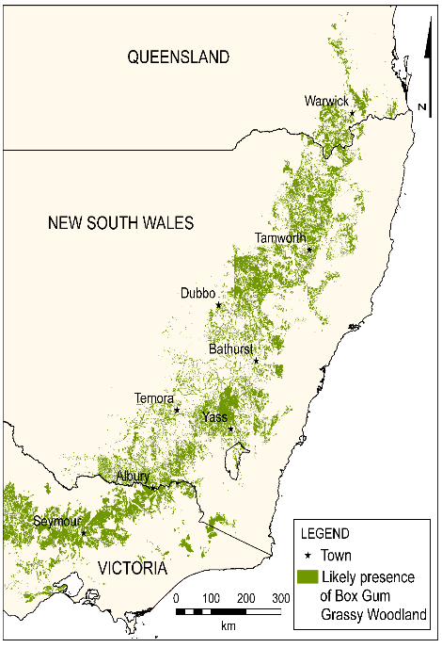
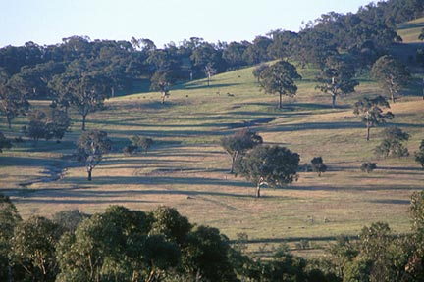
Box Gum Grassy Woodland
ecological community
Predicted historical extent of the BGGW
Critically endangered ecological community (EPBC Act):
Small areas remaining
Fragmentation
Loss of function and services
Decline in ecological condition
Degradation of the landscape
Changed environmental conditions
Continued threats that jeopardise viability

Slide 7
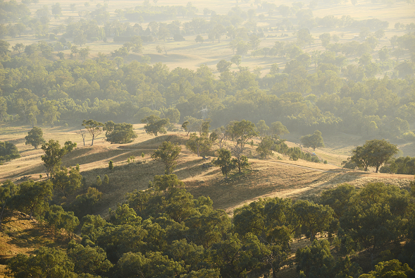
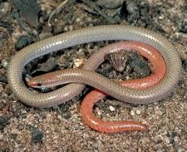
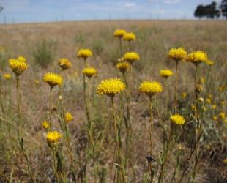
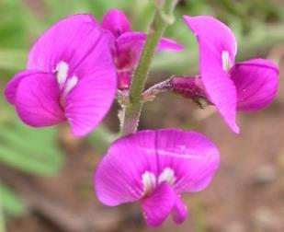
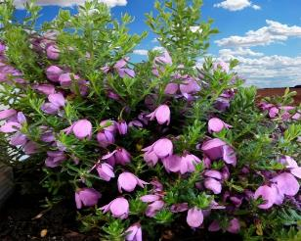
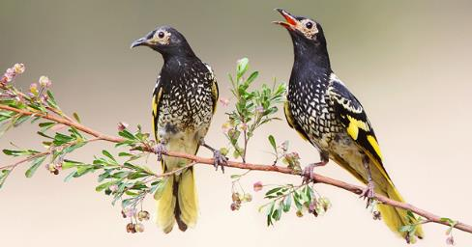
Whole ecosystem approach to managing habitat for threatened species
Pink tailed worm lizard
Button wrinklewort
Small purple pea
Fairy bells
Regent Honeyeater

Slide 8
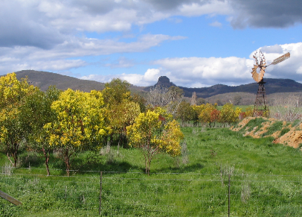
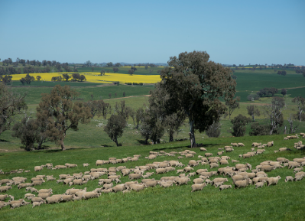
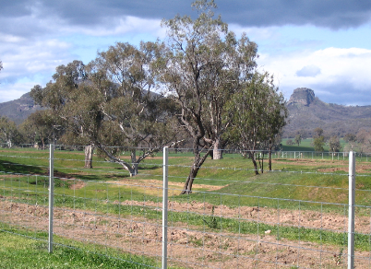
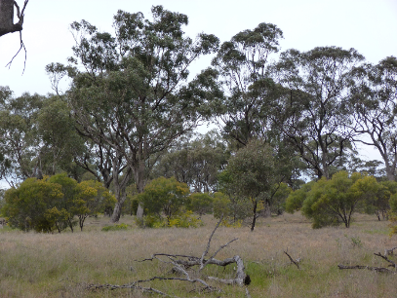
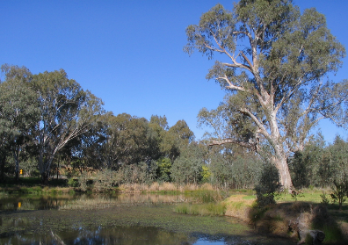
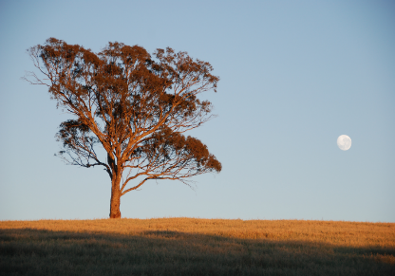
Range in condition and management of woodlands
Tree planting
Mixed farming landscape
Protecting remnant trees
Enhancing remnants with plantings
Protecting waterways
Remnant paddock trees

Slide 9
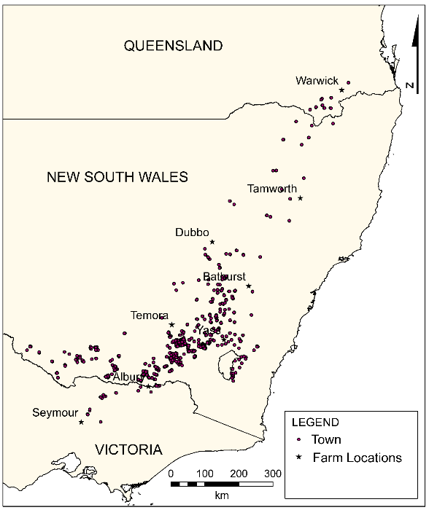
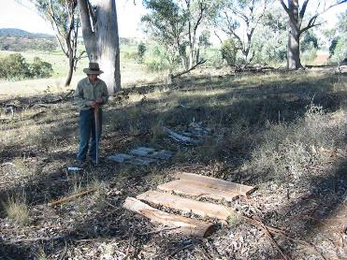
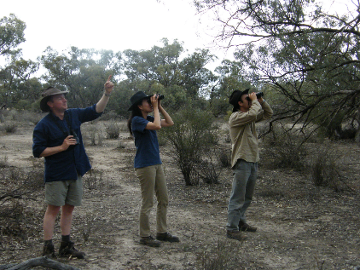
ANU long-term monitoring sites
Sites
Towns

Slide 10
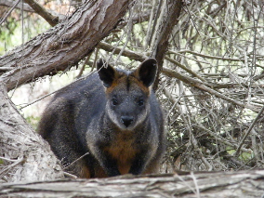
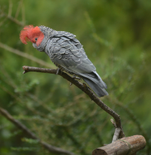
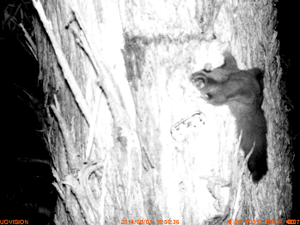
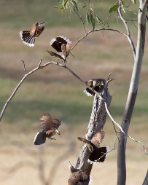
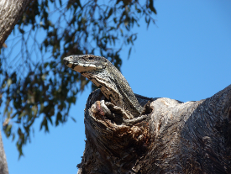
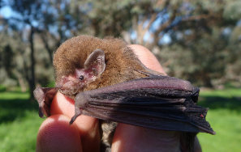
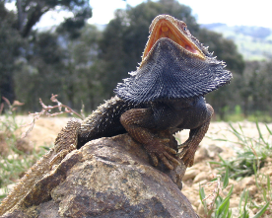
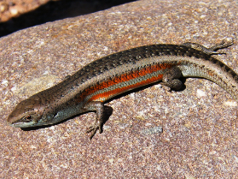
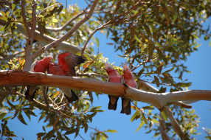
Biodiversity data
Vegetation:
Plant species richness
Vegetation structure
Native / exotic species
Tree inventory data
Animals:
Bird species richness
Reptile species richness
Mammal occurrence
Habitat attributes:
Hollow bearing trees
Bare ground
Rocky outcrops
Coarse woody debris
Litter layer
Area of woody vegetation

Slide 11
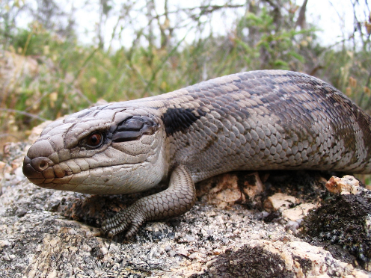
Analysis of data for ecosystem accounting
1. Change over time in biodiversity at the site scale
  An exceptional data source with long time series and geographic spread
  Capacity to test relationships between variables and different components of biodiversity
  2. Derive relationships between biodiversity variables and vegetation characteristics that can be detected by remote sensing.
  3. Calculate carbon stocks at site scale and relate to vegetation characteristics that can be remotely sensed and scaled up across the landscape.

Slide 12






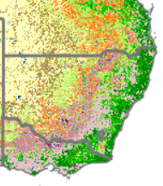
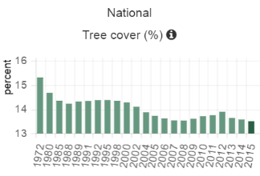
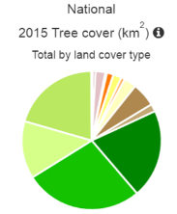
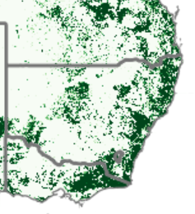
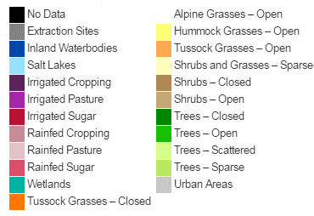
Scaling up with remote sensing
Examples from Australia’s Environment
Land Cover
Dynamic Land Cover Data (Geoscience Australia)
MODIS satellite data
250 m resolution
Annual
Tree Cover
(National Carbon Accounting System)
Forest is >20% canopy cover and 2m height
25 m resolution
Semi-annual
[Source: David Summers]

Slide 13
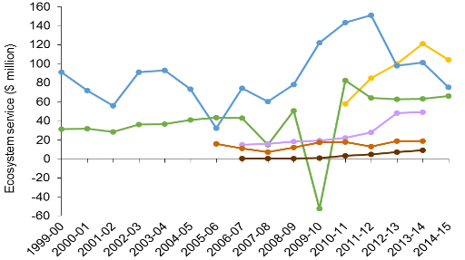
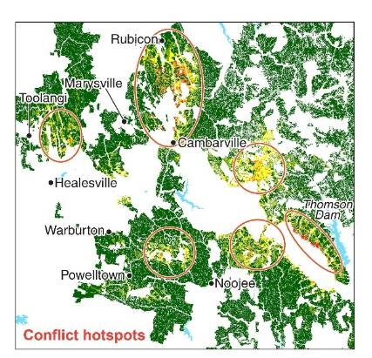
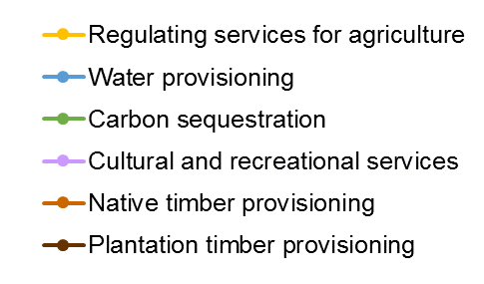

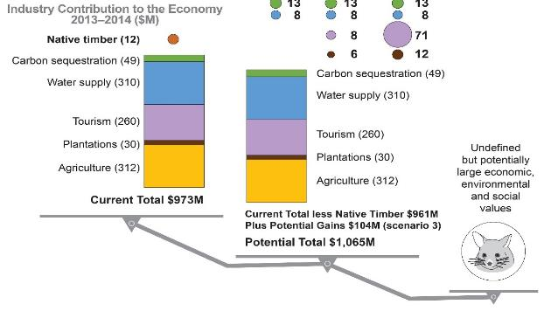
Example outputs from ecosystem accounting
Central Highlands forest region in Victoria
1. Time series
2. Spatial distribution
3. Trade-offs in values

Slide 14
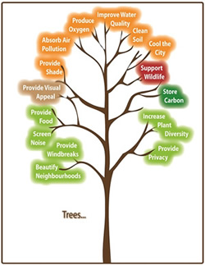

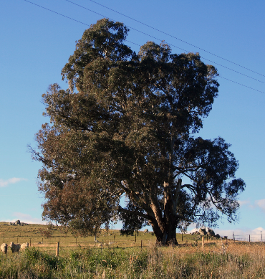

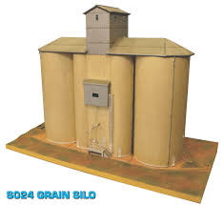
Describing value qualitatively and quantitatively
Carbon storage
Carbon sequestration
Maintaining nutrient cycling
Soil protection, erosion control
Maintaining soil fertility
Water infiltration
Maintaining groundwater
Flood mitigation
Control of pests and diseases
Pollination
Decomposition processes
Value?
Ecosystem services
$$$$
Market price for wool, meat and grain
less costs of inputs: fertilizer, pesticides, irrigation water, machinery, labour
Productivity

Slide 15

Benefits for land management from ecosystem accounts
Provides integrated information about the ecosystem, both spatially and temporally
Presents conservation of natural assets as an investment in green infrastructure rather than an expenditure
Identifies ecosystem services previously unrecognized within markets
Enables analysis of trade-offs required for management
Helps endow a social and policy licence for ongoing conservation of the ecosystem and the threatened species it supports
Creates greater social understanding of the interdependencies and thus encourages investment in conservation programs
Presents information in a common language for decision-makers in banks, insurance and agricultural businesses

