Slide 1
Conserving grassy ecosystems on national lands in Canberra
ACT Grassy Woodland Forum, 28th June 2018
Assoc. Prof. Jamie Pittock
Fenner School of Environment & Society, ANU &
National Lands Volunteer Coordinator, Friends of Grasslands
jamie.pittock@anu.edu.au

Slide 2
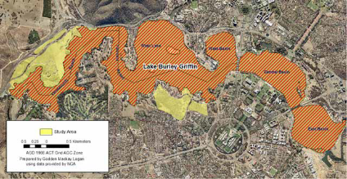
National lands
Lands reserved by the Federal Government in central Canberra for ‘national capital purposes’
Managed by the National Capital Authority
Yarramundi Reach: 23 ha of natural temperate grassland
Stirling Park: 52 ha Yellow Box – Blakely’s Red Gum grassy woodland endangered ecological community & 45,000+ plants of the endangered Button Wrinklewort
Scrivener’s Hut: ~6 ha (similar to Stirling Park)

Slide 3
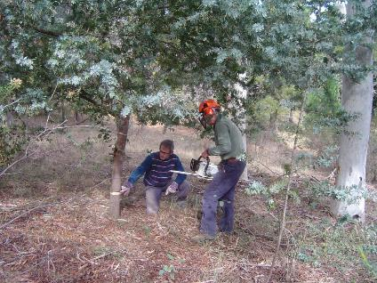
Challenges
Threatened biota
Land not zoned for conservation
Limited resources for management
Reliance on contractors
Difficult weed control & re-vegetation
Development proposals
2013

Slide 4
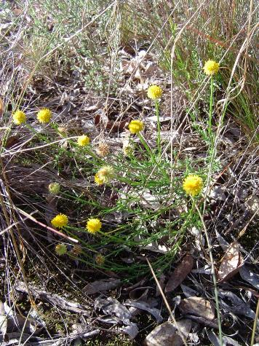
FOG-NCA partnership agreement
FOG - NCA partnership agreement 2009
Renewed 2013 & 2016
NCA $6K pa for tools, chemicals and training
NCA site conservation management plans
Collaboration on key interventions: e.g. fire, tree removal, and weed control programs

Slide 5
Conservation management plan 2016 Stirling Park, Yarralumla

Slide 6
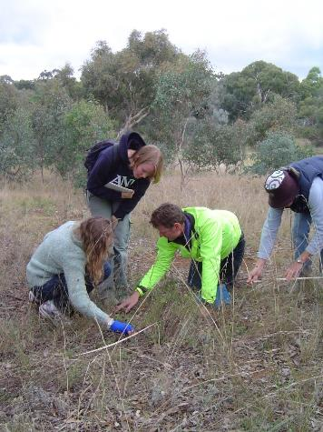
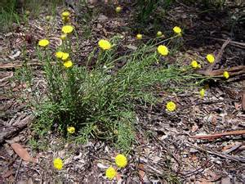
ANU-FOG-CIT Button Wrinklewort surveys 2011+

Slide 7
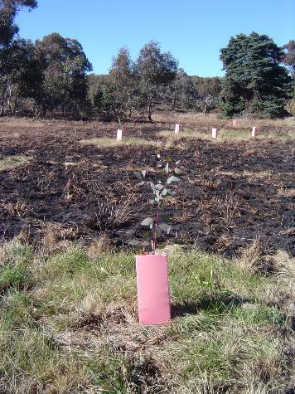
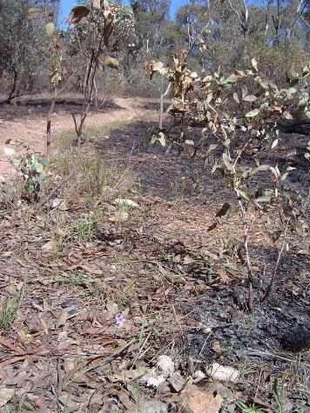
Fire, plantings & Button Wrinklewort
2011
2013

Slide 8
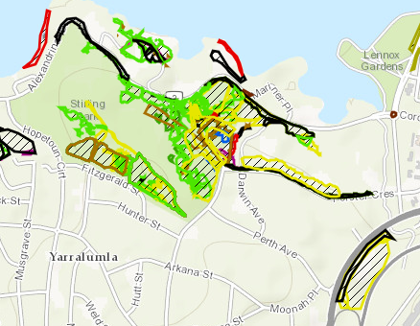
Stirling Park weed control FY18

Slide 9
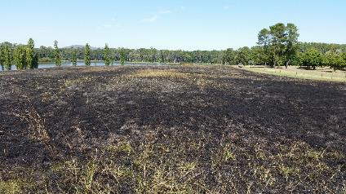
Challenges: Yarramundi Reach
Highly invasive grasses (Paspalum, Chilean Needle Grass, Wild Oats)
Burning helps but resource intensive
Only one species working for replanting (Poa sp.)
Mowing trial
Remote from residents
Skills of contractors

Slide 10
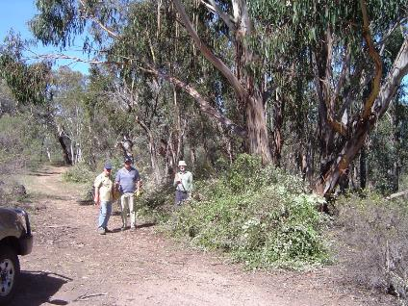
Resources leveraged 2009- 2017
98 FOG work parties: 5,862 volunteer hours
5,019 m³ woody weeds removed
Over $44K non-NCA grant funds received – thank you ACT Government
Additional management investments by:
  NCA: management planning, weed control, tree felling and burning
  Greening Australia: planting
  Canberra Institute of Technology: plant mapping and monitoring
2013

Slide 11
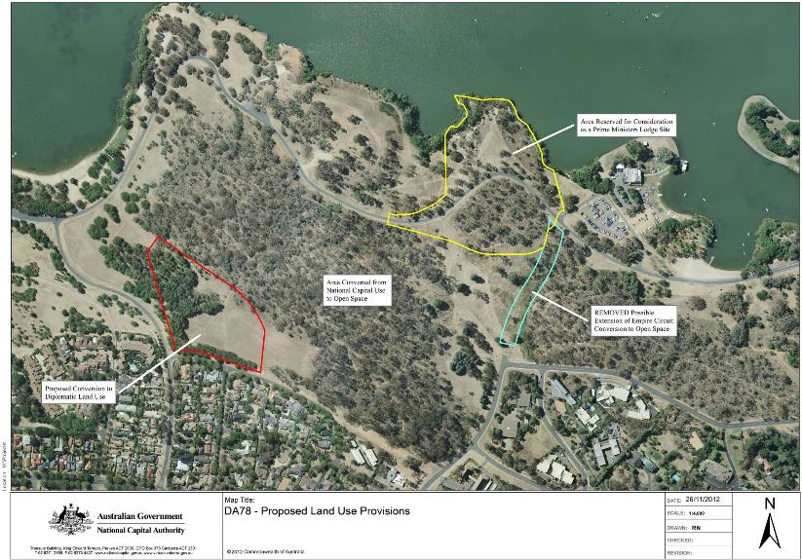
Development & zoning proposal 2012

Slide 12
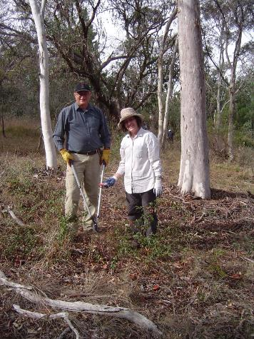
Advocacy + on ground work successes
Conservation plans
Extensive weed control
Strategic plantings
Planned fire reinstated
Local involvement
No development so far at Stirling Park
Yarramundi Reach rezoned as open space
2014

Slide 13
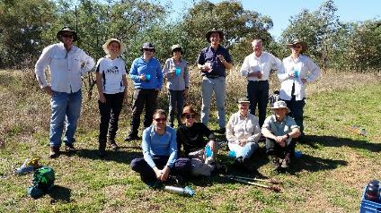
Lessons
Threatened biota a focus for conservation
Government + community works
Local residents are key
Persistence is required
Make herbicide use easy
Celebrate successes
Thanks: NCA, RFS, ANU, CIT, ACT Government, Greening Australia, Ngunawal community

