Slide 1
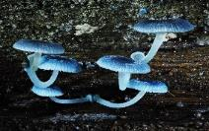
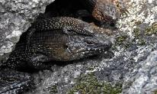
Canberra Nature Map: a useful tool for lovers of woodlands
Wildlife identification assistance
Finding out about a species distribution and abundance
Gathering and sharing wildlife data
Photographic field-guides for hundreds of places and
taxonomic groups (from gum trees to gnats)
Access to a host of willing and competent data collectors

Slide 2
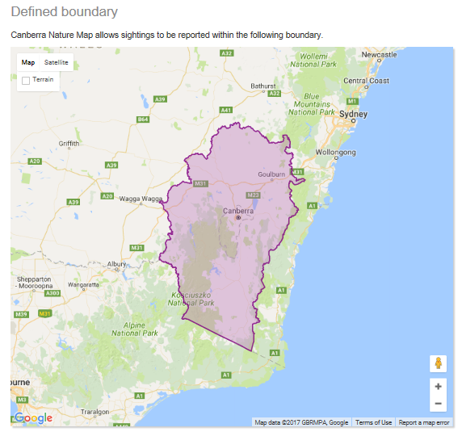
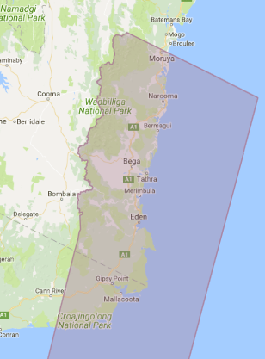
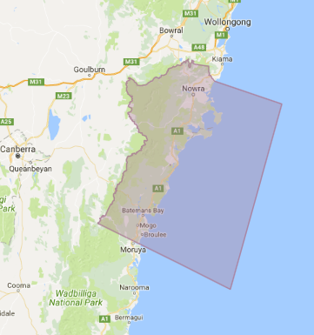

Slide 3
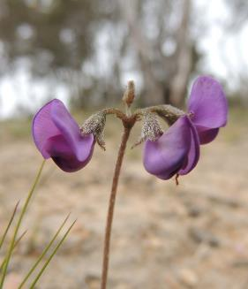
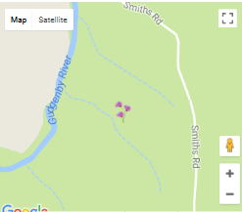
Date, author and GPS location stripped from Image
preferences
Abundance selected from dropdown menu
Register
their Email
Load image from
Smart Phone or
GPS camera
1-3
4-15
16-100
101 -1000
10001 – 10,000
10,000+

Slide 4
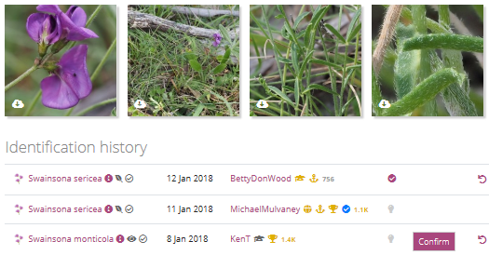
Email to expert moderator alerting them to reported record in their location or taxonomic area of expertise
Email to nature lover confirming ID or comment from moderator seeking further information
Nature Lover or any user of site can suggest an ID
Confirmed record sent on to databases

Slide 5
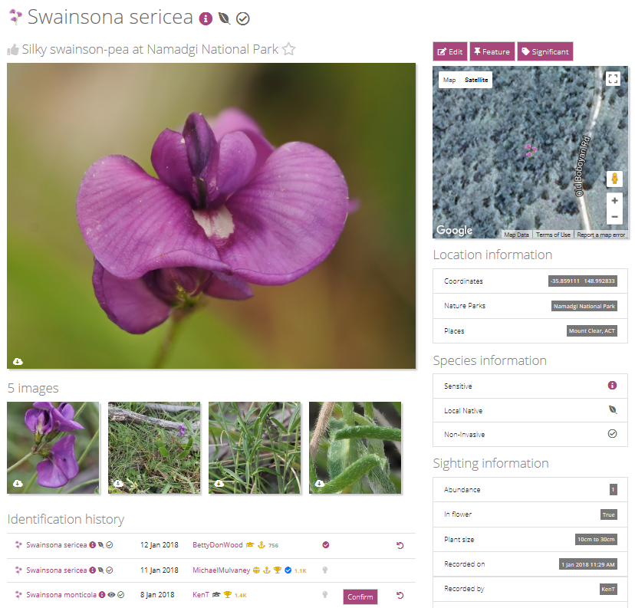
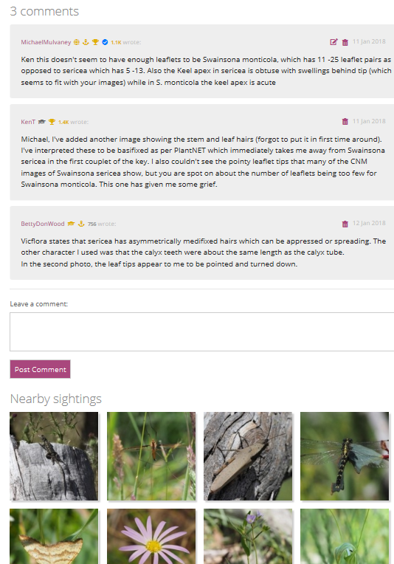

Slide 6
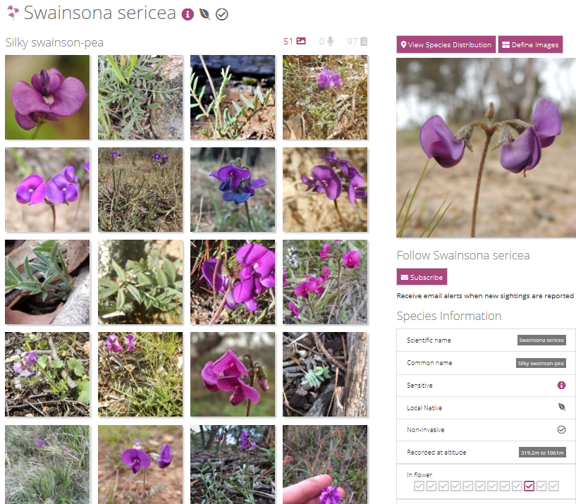

Slide 7
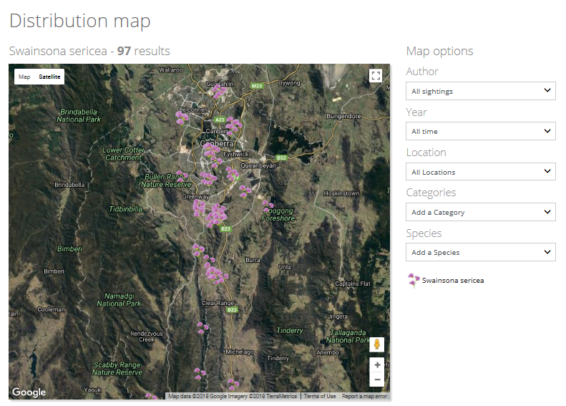
Distribution maps for over 4700 species or other taxonomic grouping

Slide 8
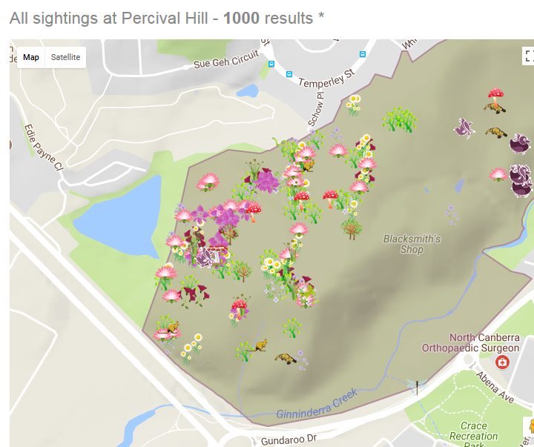
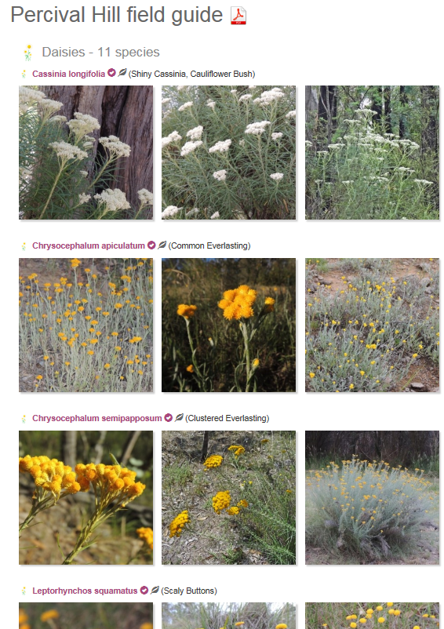
Species maps for 700 locations or make your site a new location and then print-out or search on-line site-specific photo field-guide

Slide 9
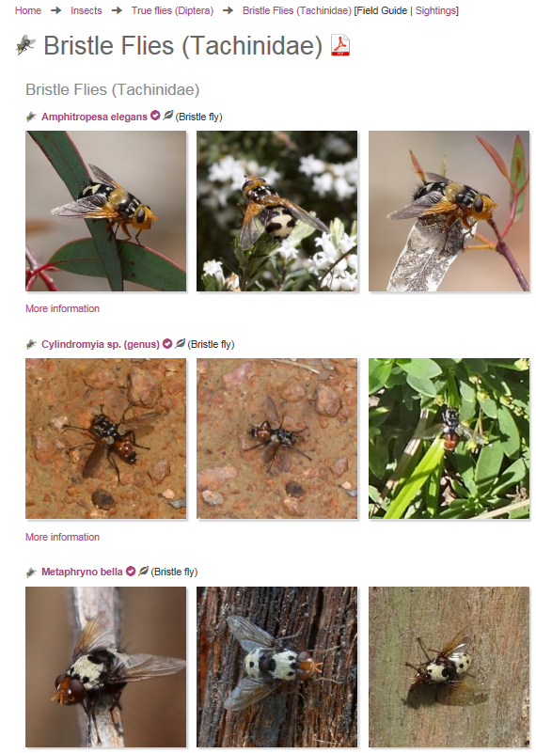
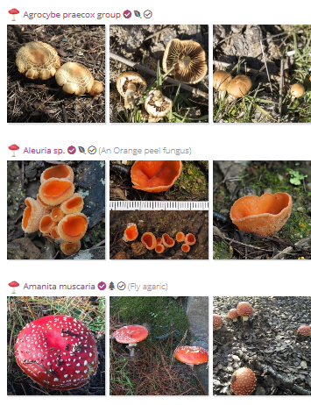
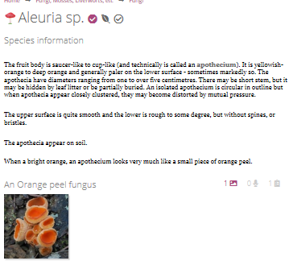
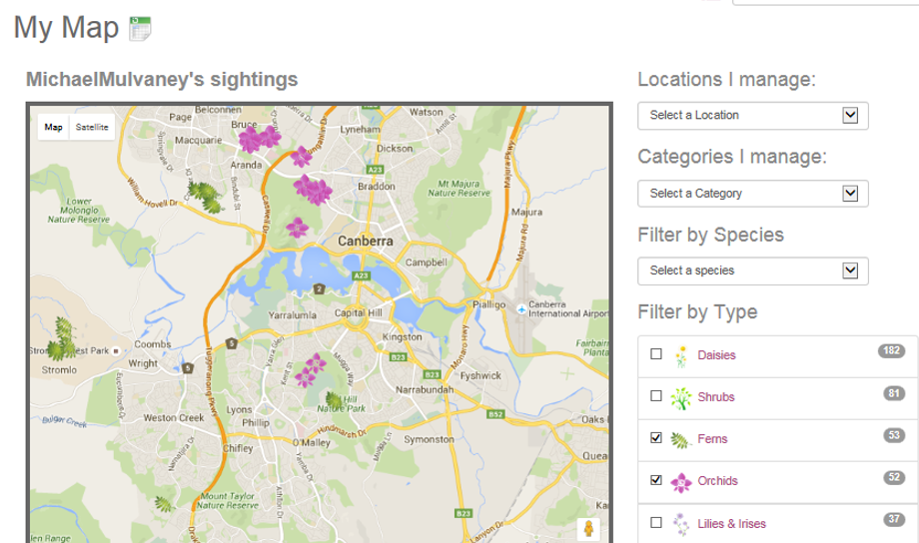
Ability to organise and view personal records

Slide 10
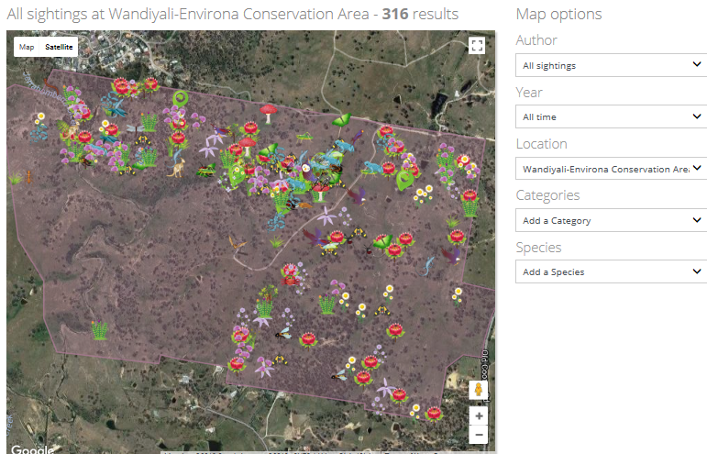

Slide 11
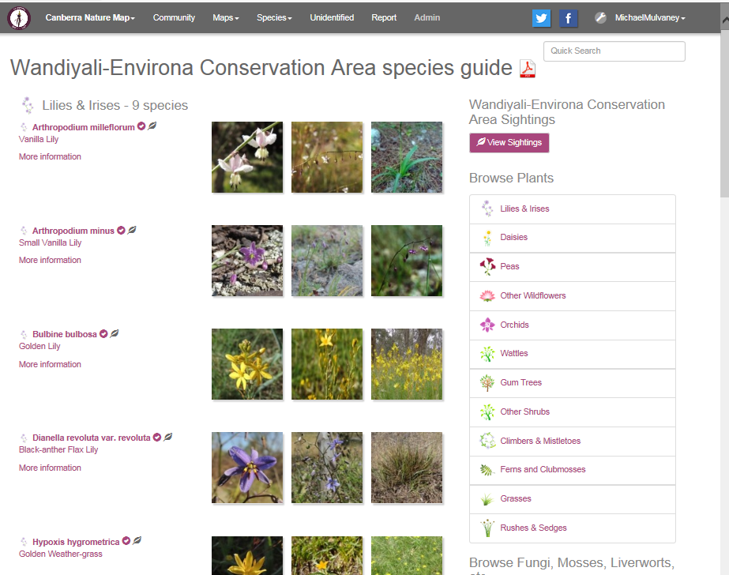

Slide 12
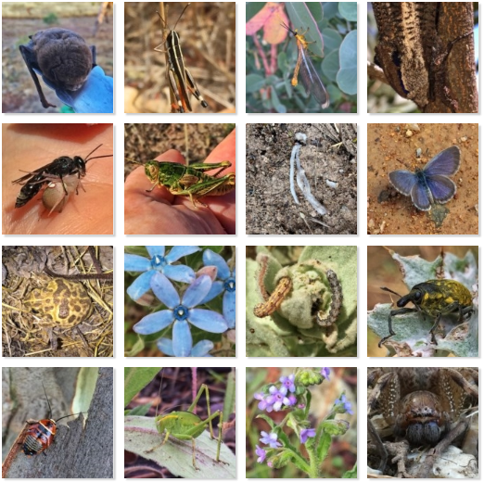

Slide 13
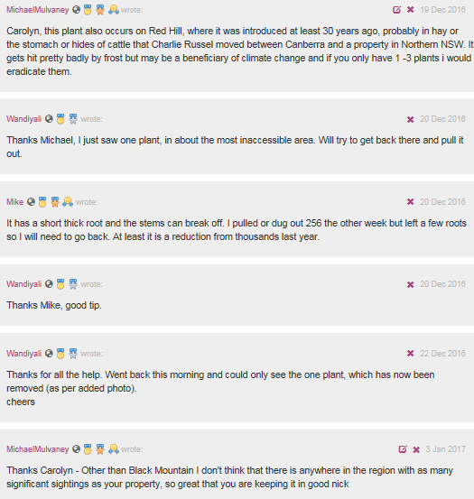

Slide 14
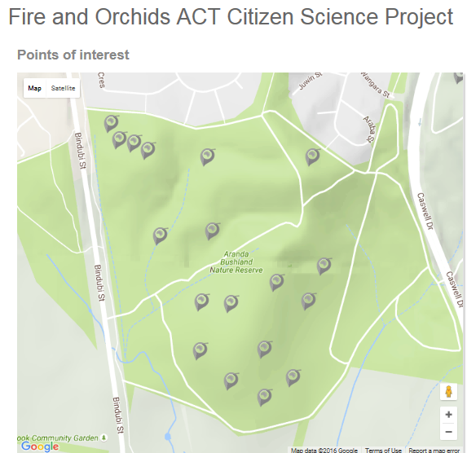
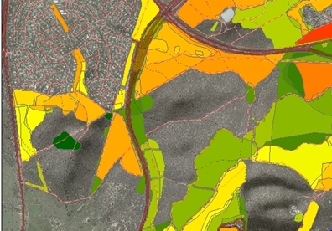
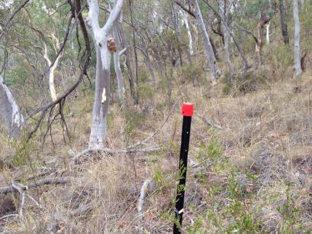
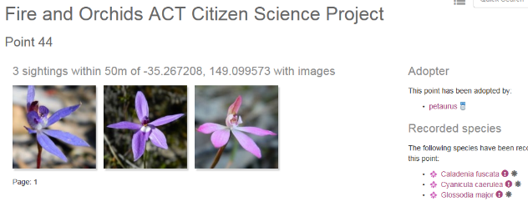

Slide 15
