Slide 1
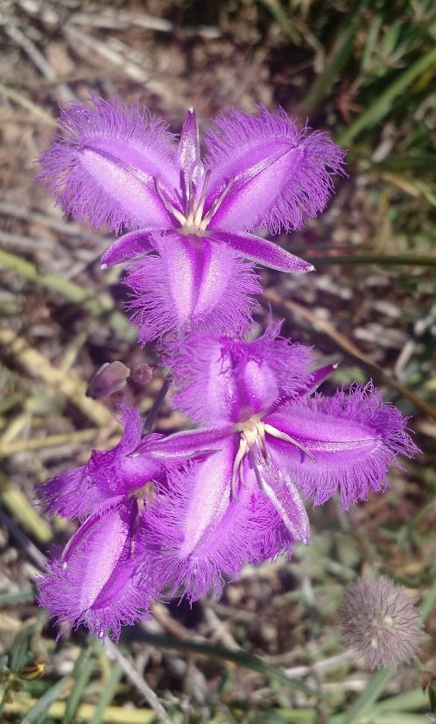
Native Woodland Conservation Strategy
Margaret Kitchin and Stacey Taylor
Conservation Research unit
Environment, Planning and Sustainable Development Directorate

Slide 2
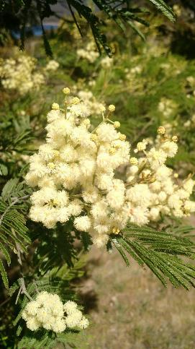
2004 ACT Lowland Woodland Conservation Strategy
Progress to date
Review process
Revised 2018-19 Woodlands strategy
Content, structure, timeline
Notes:
Margaret
Talk overview

Slide 3
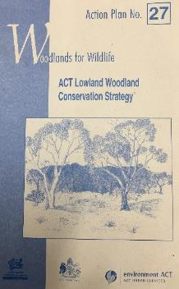
Lowland Woodland Strategy
The first (of three) ecosystem strategies – Action Plan
Action Plan 27 commenced in March 2004
Action Plan 27 focuses on 600 – 1000 m asl
With a major theme of protection from development and land use pressures
Notes:
Margaret

Slide 4
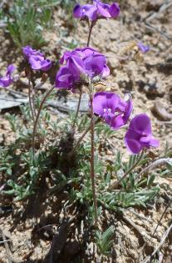
Three main goals – number 1
Conserve all types of woodland community in the ACT as viable well-represented ecological systems
Since 2004 many woodland areas have been added to the reserve network, managed as environmental offset areas or rezoned
Mt Mugga Mugga NR (2005 – 66 ha); Goorooyarroo NR + Callum Brae (2006 – 1,000 ha); Pinnacle NR (2016 – 19.5 ha including 85 ha of BG woodland)
Areas identified in the Gungahlin Strategic Assessment – e.g. Horsepark north, Taylor, Kinleyside, Jacka (+ others)
Notes:
Margaret
Work undertaken during the old Strategy
Discussion on reserves – conservation – alignment with offset processes

Slide 5
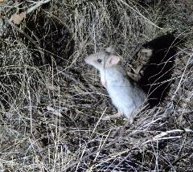
Three main goals – number 2
Conserve viable, wild population of all lowland woodland flora and fauna species in the ACT and support regional and national efforts towards conservation of these species
Kangaroo research - kangaroo grazing and birds, reptiles and beetles; grazing on vegetation
Woodland birds
Threatened plants
Mulligans Flat – Goorooyarroo woodlands experiment
Notes:
Margaret
Kangaroos
Woodland birds
Threatened species
Mulligans - GY

Slide 6
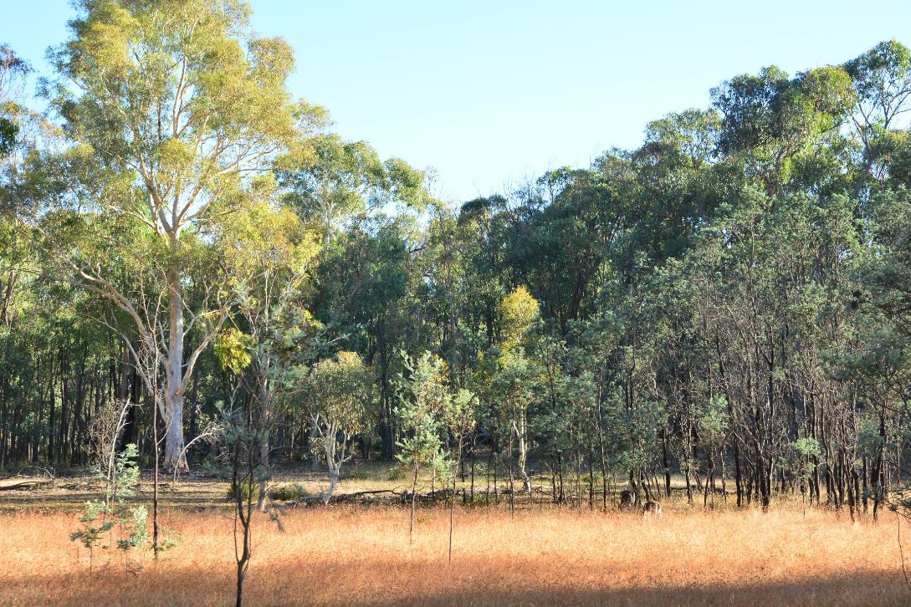
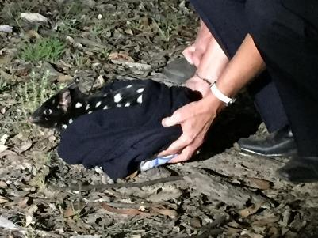
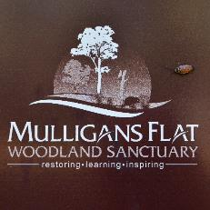
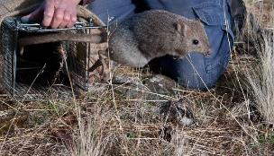
Research, innovation, people and partnerships
Notes:
Margaret
MF - research

Slide 7
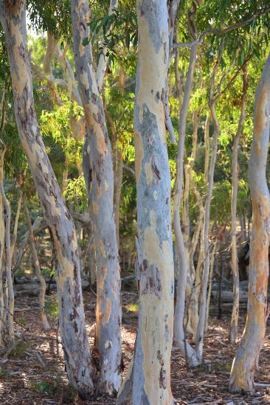
Three main goals – number 3
Manage and rehabilitate lowland woodlands across all tenures with appropriate regeneration, restoration and reinstate practices
Restoration – One Million Trees ($3.29 M); ACT Gov ($1 M); Biodiversity fund ($2.15 M); National Landcare ($1.2 M) ….
Greater Goorooyarroo woodlands – 584 ha revegetation, 4,494 ha invasive spp. control, rural landholder engagement
Coarse woody debris – research to management

Slide 8
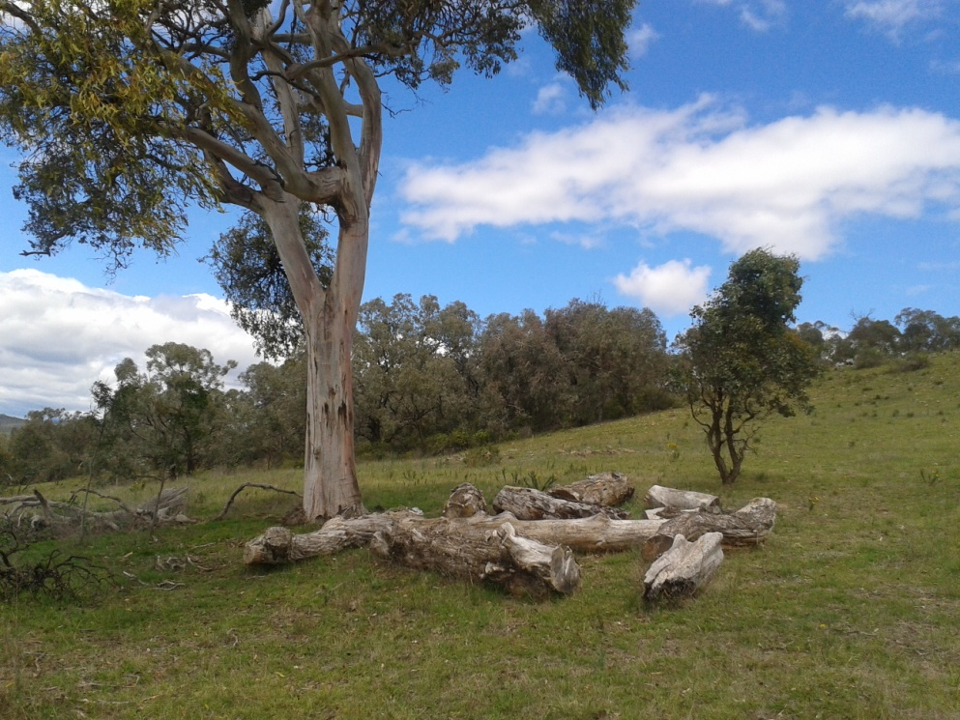
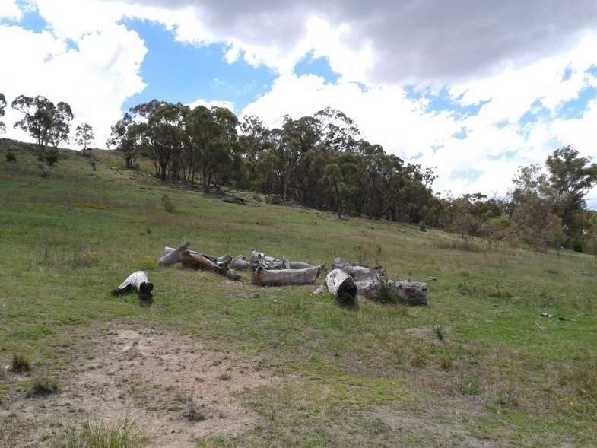
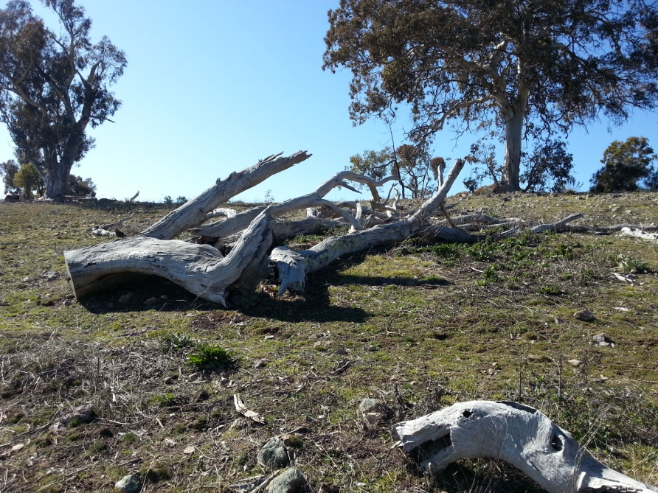
PCS addition of coarse
woody debris
Commenced in 2012
Clumped arrangement
Open areas and under trees
Mimic naturally fallen wood
Photos: Kristy Gould, PCS

Slide 9
Review process
Formal review of progress undertaken in 2017/2018
Input from Scientific Committee on scope of new Strategy
Work on Strategy structure, literature review and collation of information
Stakeholder engagement, including Grassy Woodland Stakeholder Group
Review of Action Plans / Conservation Advice for threatened species and endangered ecological community
Notes:
Stacey

Slide 10
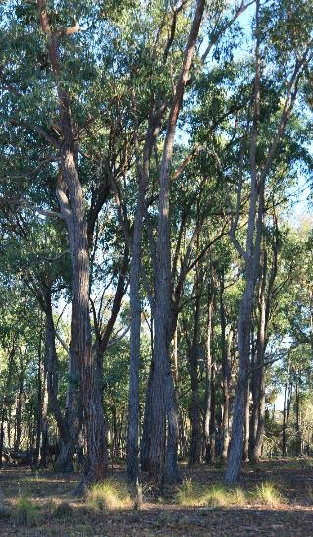
Focus and scope - revised strategy
Ongoing management of woodlands to retain their conservation values
Standalone Action Plans and Conservation Advice for threatened species and endangered ecological community
Both lowland and subalpine woodland communities, including secondary grasslands

Slide 11
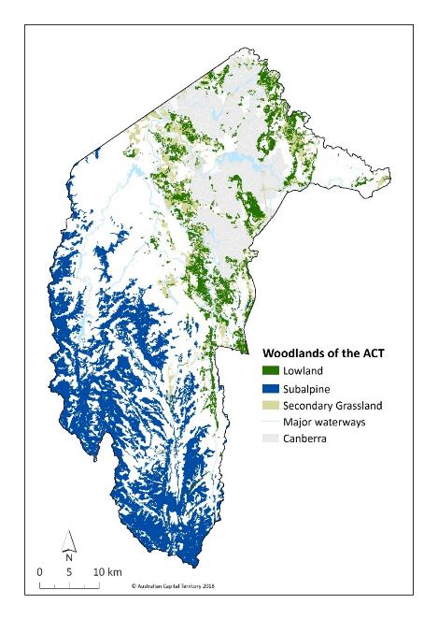
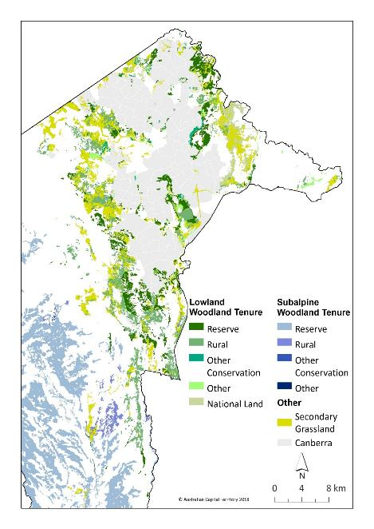

Slide 12
Structure of revised strategy
INTRODUCTION
PART A - STRATEGY
STRATEGY: PROTECT AND MANAGE WOODLAND AND COMPONENT SPECIES
1. Objective: Retain and protect native woodlands
2. Objective: Reduce threats to native woodland biodiversity
3. Objective: Enhance resilience, ecosystem function and habitat connectivity
4. Objective: Best practice management within an adaptive framework

Slide 13
Structure of revised strategy
STRATEGY: COLLABORATE WITH THE COMMUNITY
5. Objective: Promote community participation in woodland conservation
6. Objective: Support appropriate recreational and tourism use of woodlands
STRATEGY: MONITORING AND RESEARCH
7. Objective: Address knowledge gaps in woodland conservation and research
8. Objective: Monitor woodland condition
BACKGROUND INFORMATION
PART B – ACTION PLANS AND CONSERVATION ADVICE

Slide 14
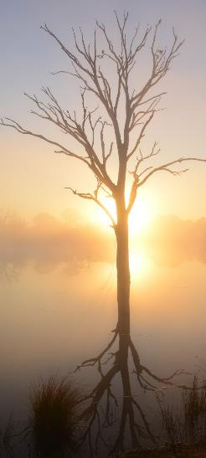
Timelines and approval process
Draft Woodland Strategy complete and Scientific Committee to review by the end of 2018
Draft Woodland Strategy released for public comment by February 2019
Woodland Conservation Effectiveness Monitoring Program (CEMP) by June 2019
Woodland Ecosystem Implementation Plan developed in 2019

Slide 15
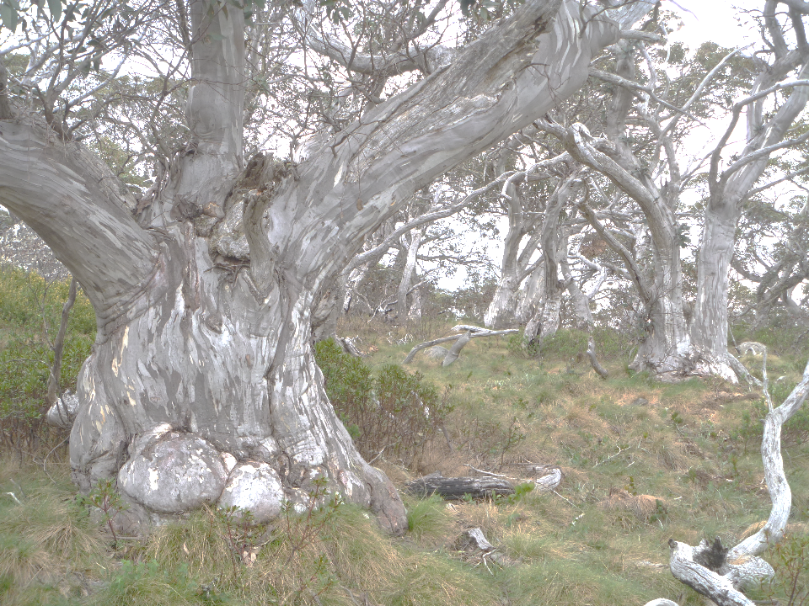
Thank you

